Slide 1
Employee Salary prediction using Linear Regression
CAPSTONE PROJECT
Presented By:
Name : Pathi Venkata Nihari
College Name : KKR And KSR Institute Of Technology And Sciences
Department : CSE-Artificial Intelligence
AICTE Internship Student Registration ID :STU669ba2c3e56f51721475779

Slide 2
OUTLINE
Problem Statement
System Development Approach
Algorithm & Deployment (Step by Step Procedure)
Result
Conclusion
Future Scope(Optional)
References

Slide 3
Problem Statement
This project aims to develop a model that predicts employee salaries based on various factors.
Understanding salary trends is crucial for both employers and employees.
Factors influencing salary include experience, education level, job role, and location.
Accurate salary predictions can help in fair compensation and budgeting.
The objective is to create a reliable model that can assist in salary forecasting.

Slide 4
System Approach
System Requirements
Component | Specification
Operating System | Windows 10 / 11 or Linux / macOS
Processor | Intel Core i5 or above
RAM | Minimum 4 GB (8 GB recommended)
Storage | At least 2 GB of free disk space
Software Environment | Jupyter Notebook / VS Code / Colab
Python Version | Python 3.7 or above

Slide 5
System Approach
Required Libraries
Library | Purpose
pandas | Data loading and manipulation
numpy | Numerical computations
matplotlib | Data visualization
seaborn | Advanced data visualization
sklearn (scikit-learn) | ML algorithms, preprocessing, model evaluation
joblib or pickle (optional) | To save and load the model

Slide 6
Algorithm & Deployment
Step 1 – Data Collection
The first step in the Employee Salary Prediction project is acquiring a dataset that includes various employee attributes. The dataset contains features such as:
Age
Work class
Education
Marital-status
Occupation
Relationship
Race
The data is loaded using tools like pandas and visualized to understand the structure and distributions.
Gender
Capital-gain
Capital-loss
Hours-per-week
Native-country
Income

Slide 7
Algorithm & Deployment
Step 2 – Data Preprocessing
To prepare the dataset for machine learning, several preprocessing steps were applied:
Label Encoding: All categorical features (workclass, marital-status, occupation, relationship, race, gender, native-country) were encoded using LabelEncoder from sklearn.preprocessing, converting text categories into numerical labels.
Feature-Target Split: The target column income (if categorical) can be converted to binary (0 and 1). If actual salary is provided, that becomes the regression target.
Train-Test Split: Data is split into training and test sets using an 80-20 split to evaluate model performance.

Slide 8
Algorithm & Deployment
Step 3 – Model Building and Training
After preprocessing, the machine learning model is trained on the cleaned dataset.
Model Comparison: Along with Linear Regression, models like Decision Tree Regressor and Random Forest Regressor were also tested.
Observation:
Linear Regression performed well and gave consistent predictions.
Decision Tree and Random Forest provided slightly better accuracy but were more complex.
For simplicity and interpretability, Linear Regression was selected as the final model.

Slide 9
Algorithm & Deployment
Step 4 – Model Evaluation
After the model is trained, predictions are made on the test set, and performance is evaluated using regression metrics:
Mean Absolute Error (MAE): Measures average magnitude of prediction errors.
Mean Squared Error (MSE): Penalizes larger errors more than MAE.
R² Score: Indicates how much variance in the target is explained by the model.
These metrics help determine how well the model performs in predicting salary.

Slide 10
Algorithm & Deployment
Step 5 – Model Deployment
This project uses the trained model to generate salary predictions directly within the development environment.
The trained model is used to predict salaries on test data.
Predictions are compared with actual values to check accuracy.
Results are displayed in tabular format using pandas.

Slide 11
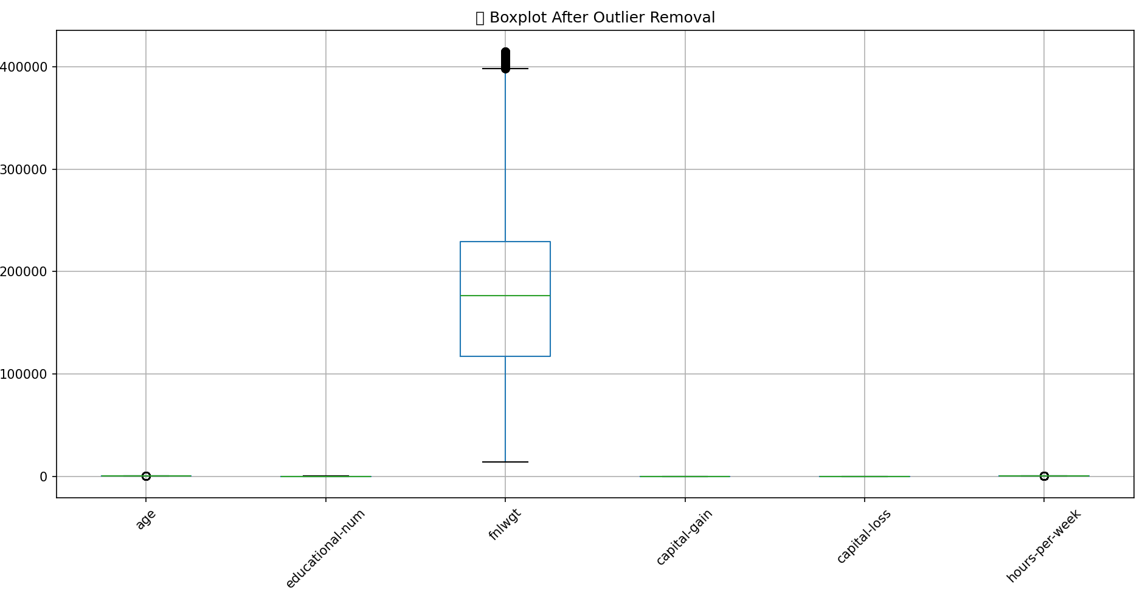
Result
Visualize boxplots after removal of Outliers

Slide 12
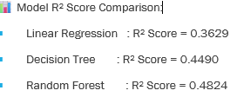
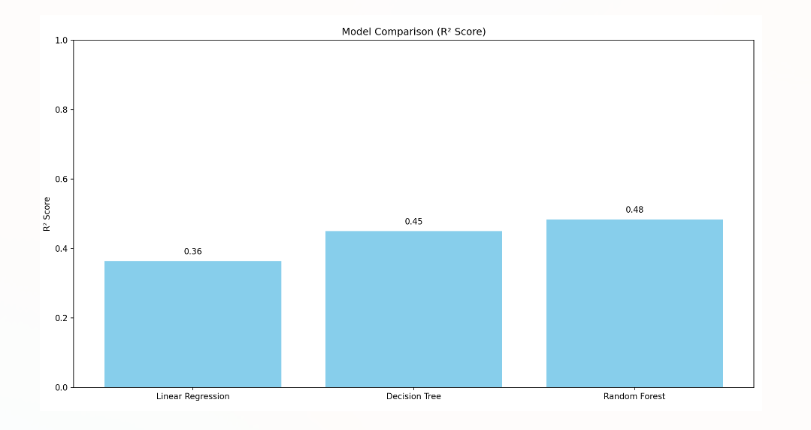
Result
Evaluation of the best model: Random Forest Regression

Slide 13
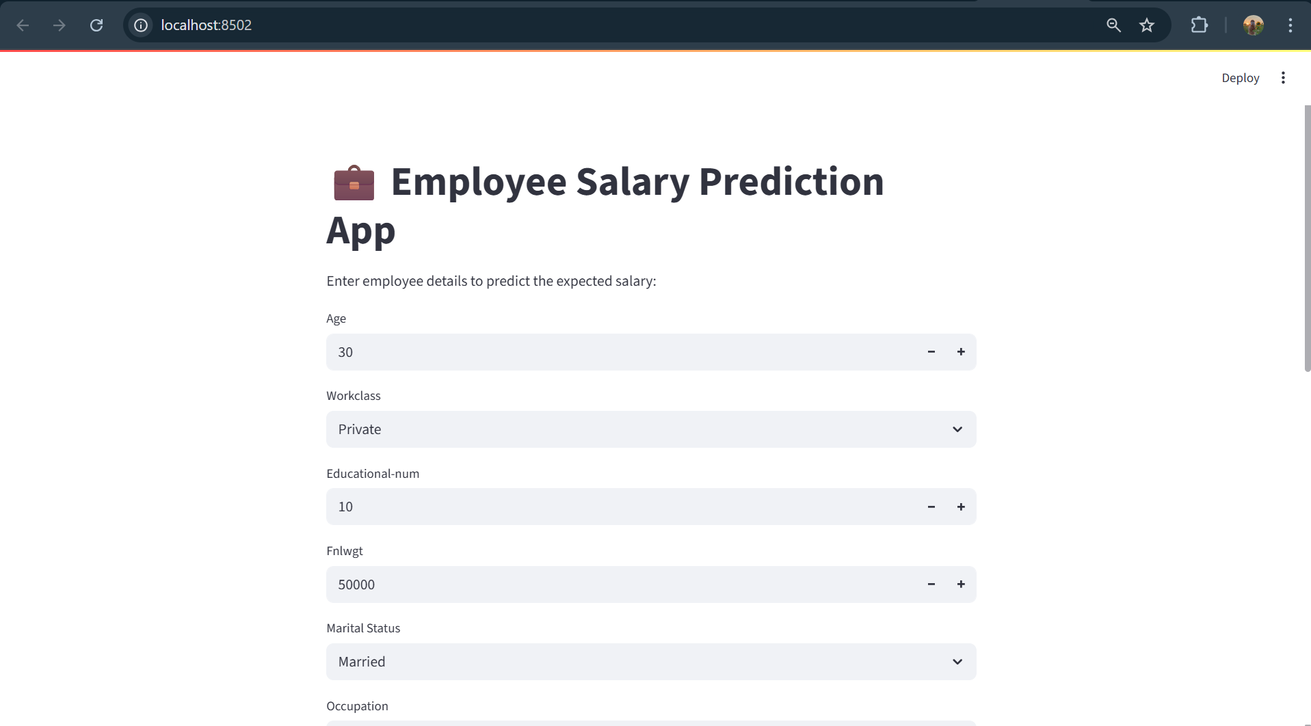
Result
STREAMLIT INTERFACE

Slide 14
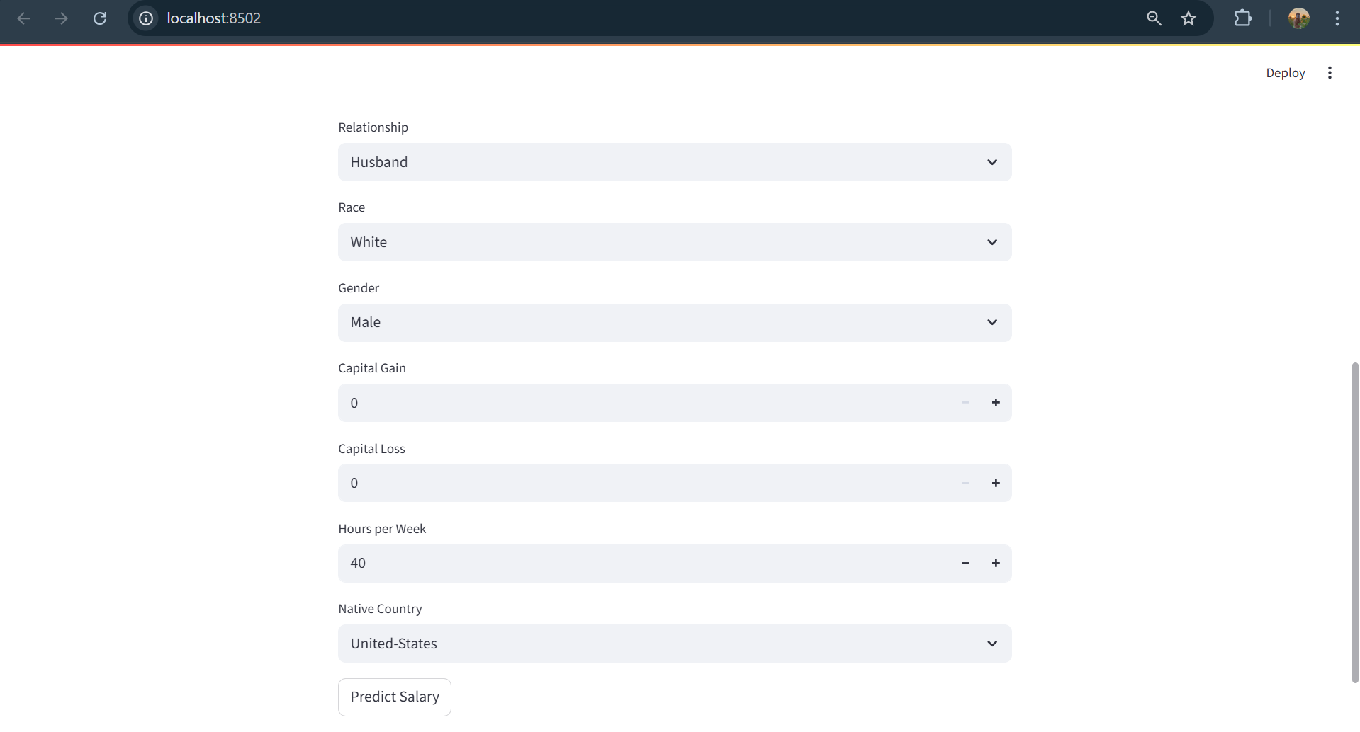
Result
STREAMLIT INTERFACE
GITHUB LINK: https://github.com/nihari06/employee_salary_predict.ipynp

Slide 15
Conclusion
Random forest regression gave the best results due to its simplicity and effective prediction performance.
Outlier removal (IQR method) improved model accuracy and data quality.
The model showed a strong relationship between features and salary, with good R² score.
Streamlit app made the solution user-friendly and easy to deploy.

Slide 16
Future scope(Optional)
Add more features such as experience, location, domain expertise, and performance ratings to improve prediction accuracy.
Integrate dynamic datasets that update automatically as employee records change.
Deploy via cloud platforms (like Heroku, AWS, or Streamlit Cloud) for real-time multi-user access.
Enable salary range prediction using classification (e.g., Low, Medium, High).
Incorporate resume parsing or LinkedIn API to predict salaries from profiles.
Build a dashboard to visualize employee trends, salary distributions, and model metrics.

Slide 17
References
Scikit-learn Documentation – Used for machine learning models, encoding, and model evaluation
Pandas Documentation – Used for data preprocessing, handling, and transformations
3.Streamlit Documentation – Used to build and deploy the web application interface
4.Matplotlib & Seaborn Libraries – Used for visualizations and data plotting
5.Kaggle & UCI Repository – For reference datasets and feature selection inspiration
6.Python Official Documentation – Language reference for writing and debugging the code

Slide 18
THANK YOU

